Slide 1
Tutorial 3

Slide 2
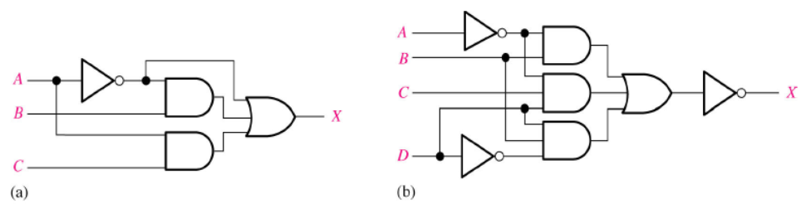
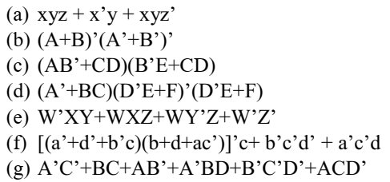

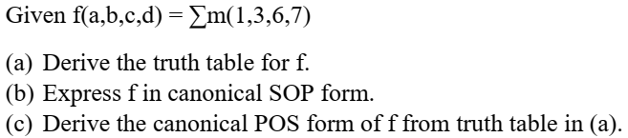

Question 3: Simplify the logic expressions using Boolean algebra:
Question 4: convert to SOP and POS form.
Question 5:
Question 1: Write the Boolean expression:
Question 2: Implement the logic circuit:

Slide 3
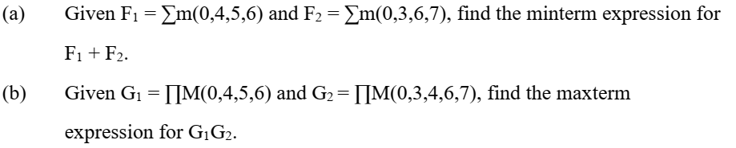
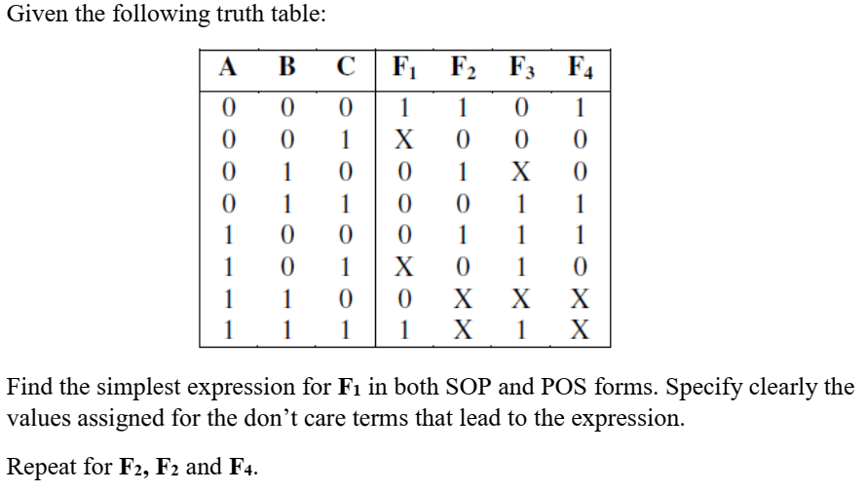
Question 6:
Question 7: Implement the logic circuit:

